Slide 1
Spiritual Crisis in the Ecological Crisis

Slide 2
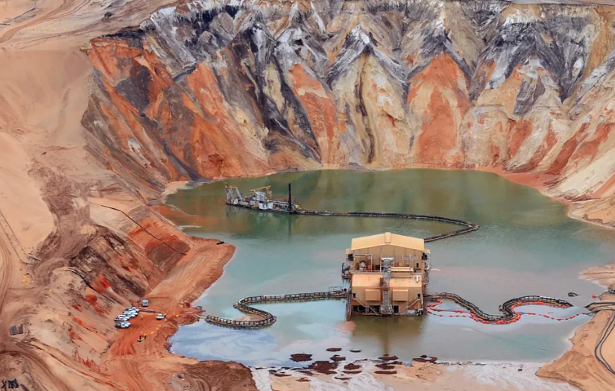

Slide 3
Anthropocene?
“To deny that global warming is real is precisely to deny that humans have become geological agents, changing the most basic physical processes of the earth.For centuries, scientists thought that earth processes were so large and powerful that nothing we could do could change them. This was a basic tenet of geological science: that human chronologies were insignificant compared with the vastness of geological time; that human activities were insignificant compared with the force of geological processes. And once they were. But no more. There are now so many of us cutting down so many trees and burning so many billions of tons of fossil fuels that we have indeed become geological agents. We have changed the chemistry of our atmosphere, causing sea level to rise, ice to melt, and climate to change. There is no reason to think otherwise.” Naomi Oreskes
Humans, as a collective force, become a geological agent. We are living in different conditions, the planet is changing and currently going through a deep modification. We are leaving the Holocene.

Slide 4
Who, what kind of human, made this mess? When did it started? Time-being
Rudimann: Neolitic Revolution as responsible for the changes in the Earth System. Agriculture and the use of fire.
Orbis Spike (1610): Simon Lewis and Mark Williams. Drop of CO2 in the ice cores related to the death of 90 % of the indigenous population in the Americas. More carbon capture.
Capitalocene: Jason Moore, Andreas Malm. Cheap Nature
Great Aceleration: Anthropocene Working Group (Zalaziewics, Steffen).
The Shock of the Anthropocene by Cristophe Boneuille and Jean Baptiste Fressoz.

Slide 5
Extinction
“Anthropogenic global climate change is now emerging as what may become the most significant extinction driver of all time, amplifying the already potent mix of anthropogenic pressures behind what is increasingly called Earth’s sixth mass extinction… Ecologist Stuart Pimm, palaeontologist Tony Barnosky, and others have demonstrated that current extinction rates for vertebrates, estimated in extinctions per million species per year, are now at least ten and potentially up to 1,000 times higher than the historical baseline and have increased dramatically in recent centuries.”

Slide 6
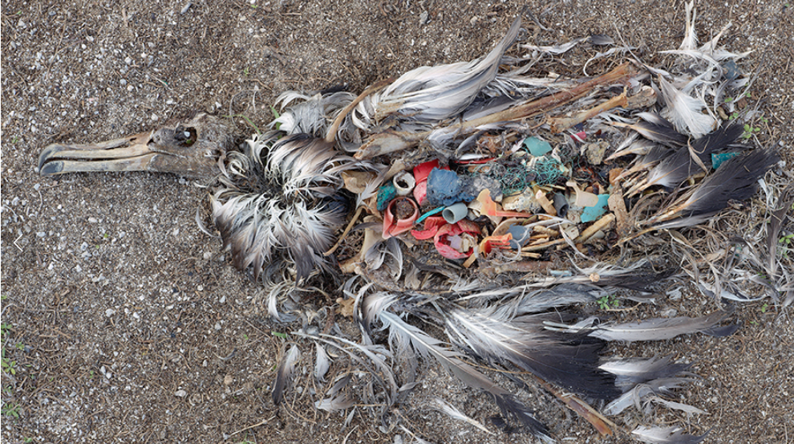
Notes:
Chris Jordan

Slide 7
What is Extinction? What is lost?
“Millions of years before anything like the human species appeared on the scene, albatrosses were already soaring, dancing, and fishing across this great blue planet.”
We often do not appreciate—and perhaps we cannot truly grasp—the immensity of this intergenerational work: the skill, commitment, cooperation, and hard work, alongside serendipity, that are required in each generation to carry the species through.It is with recognition of this embodied intergenerational achievement that I understand species as “flight ways.” This understanding is possible only since Darwin. Central to the mode of thought that evolutionary theory opened up is the transition from an understanding of a species as a fixed and eternal “kind” to that of something more akin to a historical lineage stretched between a beginning (speciation) and an inevitable end (extinction).5 In this context, a species must be understood as something like a “line of movement” though evolutionary time. But it is much more than an empty trajectory.
van Dooren, Thom. “Flight Ways”. iBooks.

Slide 8
What do we call a World?
Modern idea: Environment – Mechanistic – Background. No agency at all!
Earth System: processes of the Earth interrelating with each other. Life, from microorganisms to mammals, have played a dramatic role in its formation (Gaia). Human activities become part of the this process (Anthropocene).
“The Earth System is defined as the integrated biophysical and socioeconomic processes and interactions (cycles) among the atmosphere, hydrosphere, cryosphere, biosphere, geosphere, and anthroposphere (human enterprise) in both spatial —from local to global—and temporal scales, which determine the environmental state of the planet within its current position in the universe. Thus, humans and their activities are fully part of the Earth System, interacting with other components.” Rockstrom et al.

Slide 9
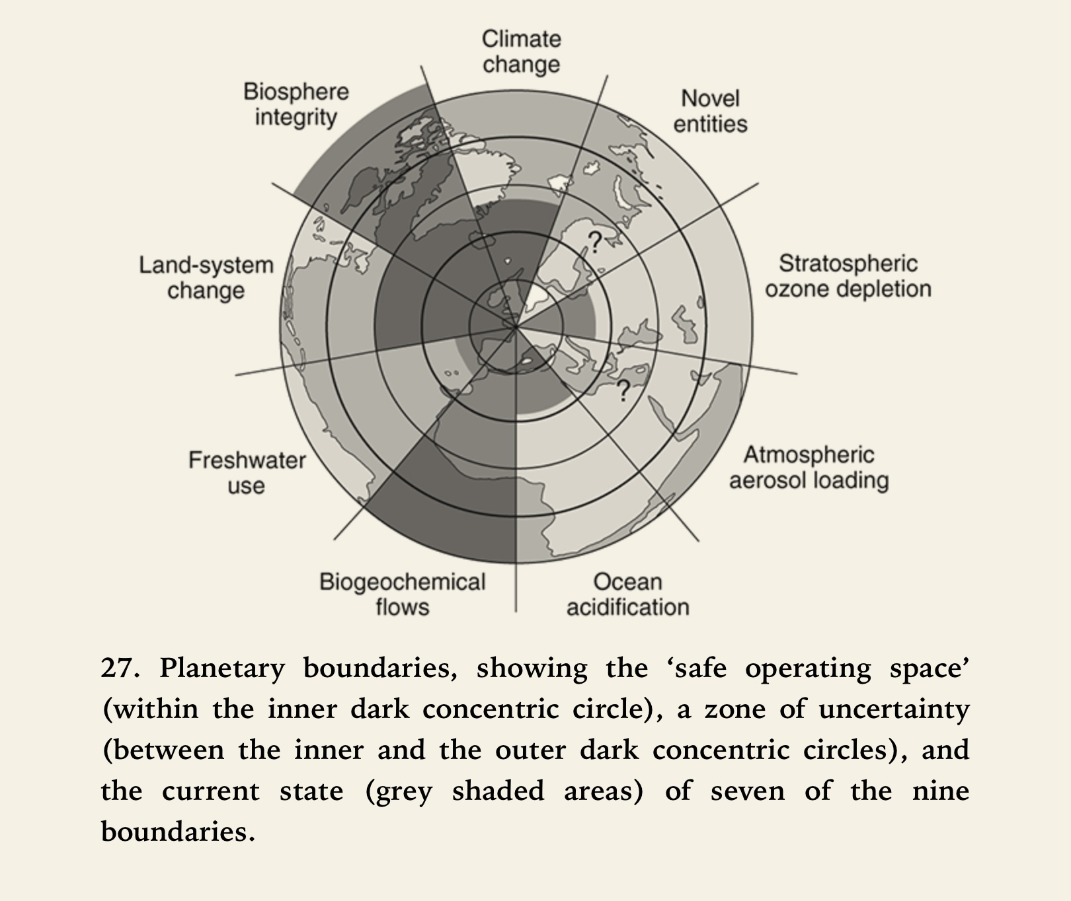
Planetary Boundaries

Slide 10
Actualizing the Practice
A Great De-acceleration.
Askesis of Desire - Consumerism.
A Reational Ontology. Interdependence-Gaia.
Emptiness, non intrinsic identity. Does the notion of emptiness denies personhood or amplifies personhood in an no hierarchical way? Agency of earthlings.

